Slide 1

Data Mining Final Project Car Sales

Slide 2

Outline
Explanatory Data Anlysis
Data Information
Data Cleaning
Feature Explore
Some Insights (Knowing Data)
Model Evaulation 1: Predicting car sale prica based on make and year.
Feature Engineering
Summary

Slide 3
Explanatory Data Analysis Data Information
Red marked features are mostly used for predictions.
Feature | Description
Year | The manufacturing year of the vehicle.
Make | The brand or manufacturer of the vehicle.
Model | The specific model of the vehicle.
Trim | Additional designation for the vehicle model.
Body | The body type of the vehicle (e.g., SUV, Sedan).
Transmission | The type of transmission in the vehicle (e.g., automatic).
Vin | Vehicle Identification Number, a unique code for each vehicle
State | The state where the vehicle is registered
Condition | Condition of the vehicle, possibly rated on a scale.
Odometer | The mileage or distance traveled by the vehicle.
Color | Exterior color of the vehicle.
Interior | Interior color of the vehicle.
Seller | The entity selling the vehicle
Mmr | Manheim Market Report, possibly indicating the estimated market value of the vehicle.
Selling price | The price at which the vehicle was sold.
Sale date | The date and time when the vehicle was sold.

Slide 4
Explanatory Data Analysis Data Cleaning
Current car prices data set has 558837 rows and 16 features. We will be remoing some of the data from the dataset due to below reasons
Data set: Shape: (558837, 16)
After Cleaning NA Values: (472325, 16) → 86512 rows
After removing early 2000 models: (465953, 16) → 6352 rows
After removing very less sold models: (465659, 16) → 294 rows
After removing less than 100 sold cars: (455713, 16) → 9946 rows
After removing 1 USD car sale prices(442520, 16) → 13193 rows
Total 116317 rows removed to have a clean data to make a better prediction and insights

Slide 5
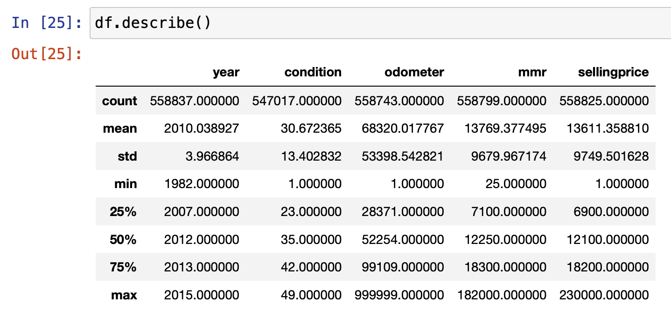
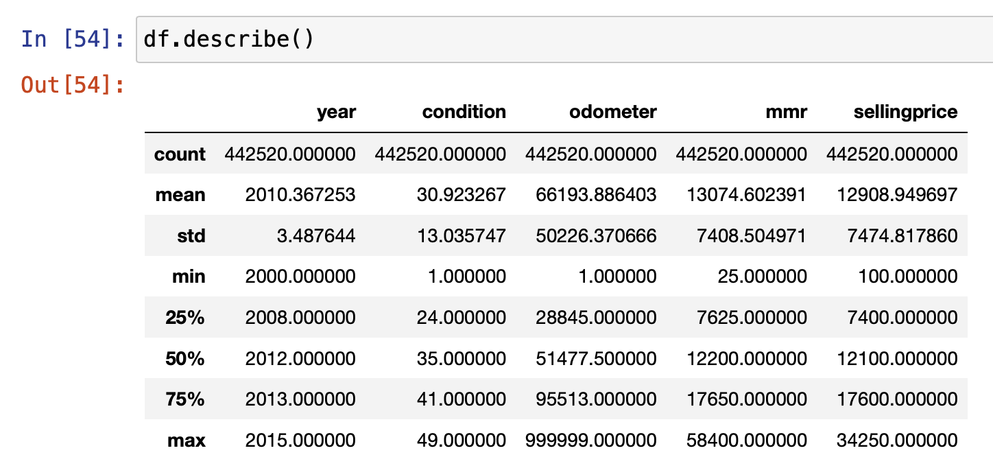
Explanatory Data Analysis Data Cleaning
After cleaning data set statsitical changes can be seen.
Year feature adjusted between 2000-2015.
Condition and Odometer did not changed and din’t used for any prediction
MMR didn’t change since this is the market price and used to calculate to understand selling price
There were 13193 rows removed less than 100 USD car sales hence seems unrealistic to be sold with that price

Slide 6
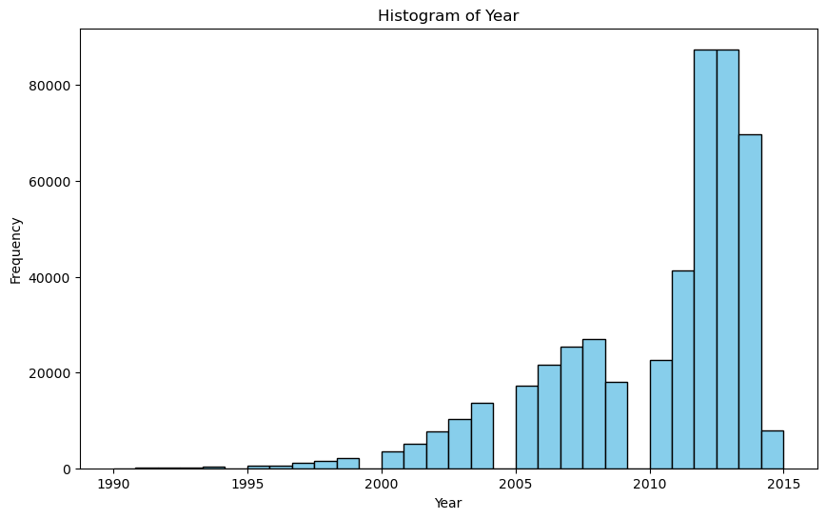
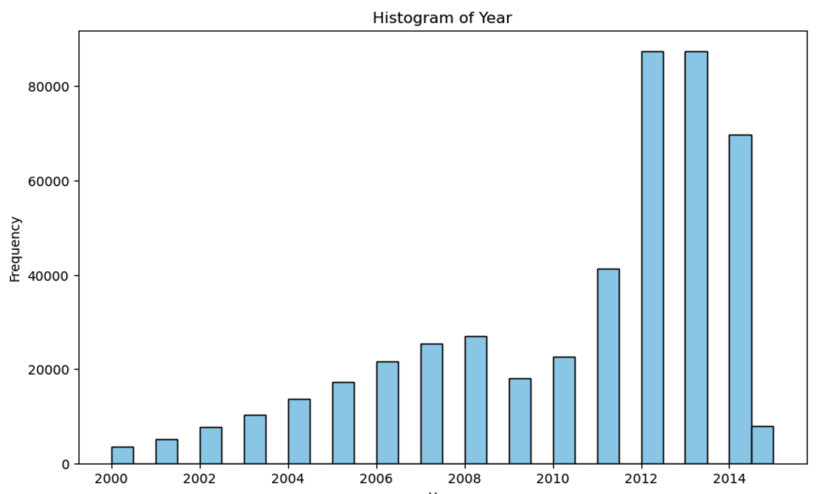
Explanatory Data Analysis Data Cleaning – Year Feature
Since there were very small set of data earlier than year 2000, for the better precition those rows are removed

Slide 7
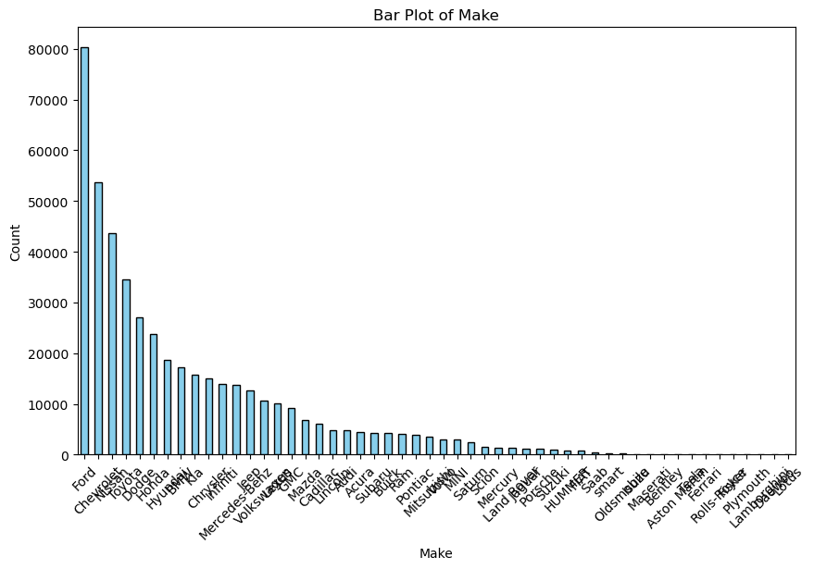
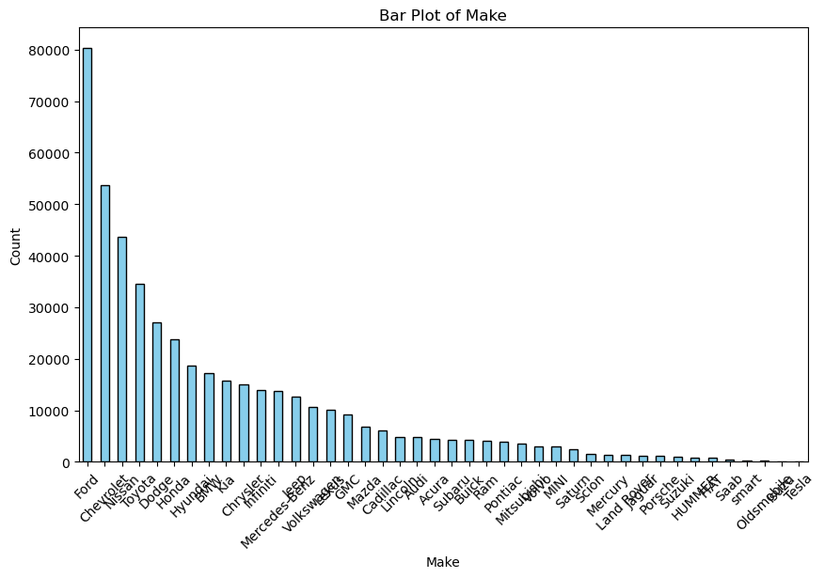
Explanatory Data Analysis Data Cleaning – Make Feature
Very less sale data of the cars are removed. Especially supersport cars having outlier from the number of sales and saleprice perspective. Makes rows removed like: Lotus, Daewoo, Lamborghini, Plymouth, Fisker, Rolls-Royce, Ferrari, Aston Martin, Bentley, Maserati

Slide 8
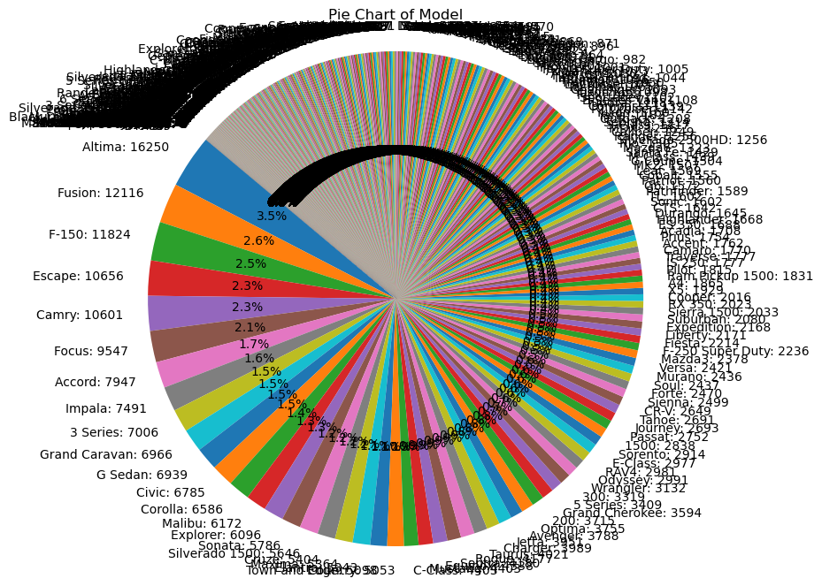
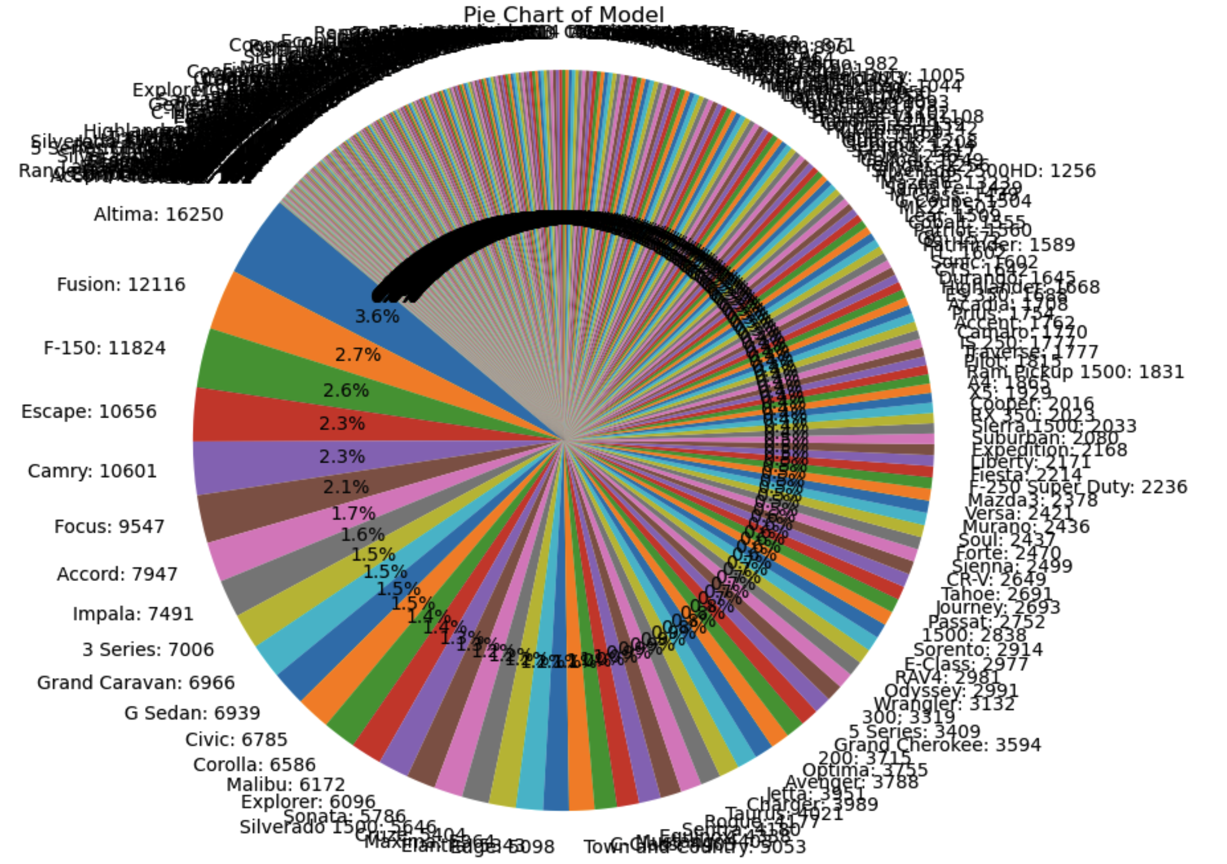
Explanatory Data Analysis Data Cleaning – Model Feature
Most of the very less model records are removed

Slide 9
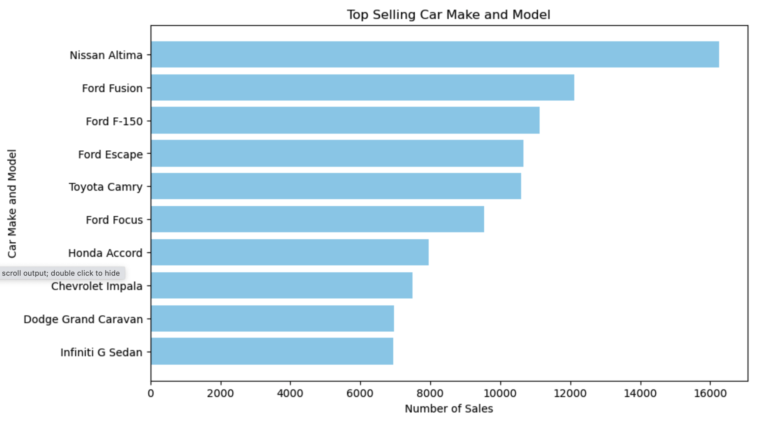
Explanatory Data Analysis Data Cleaning – Feature Explore
Top 5 selling car models are Nissan Altima, Ford Fusion, Ford F-150, Fors Escape, and Toyoa Camry

Slide 10
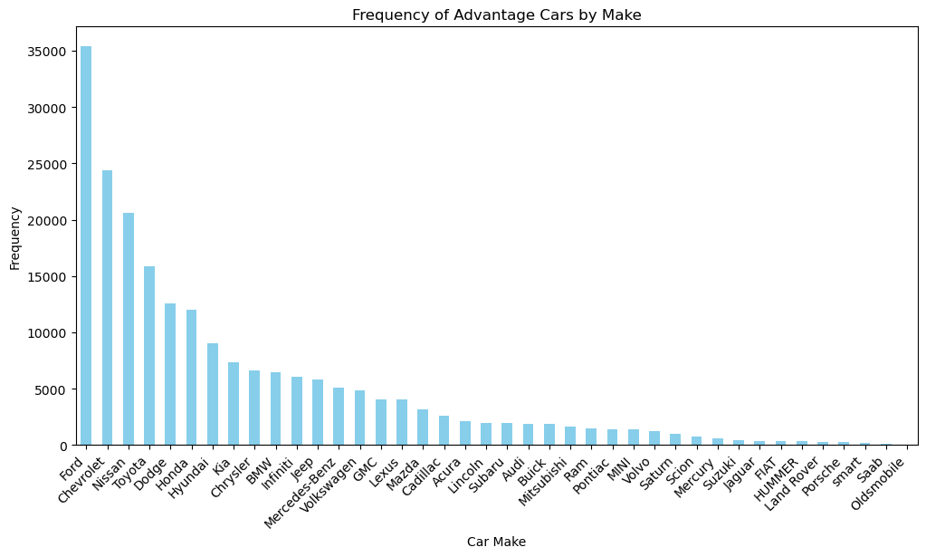
Explanatory Data Analysis Data Cleaning – Feature Explore
Top 5 selling car brands are Ford, Chevrolet, Nissan, Toyota, and Dodge

Slide 11
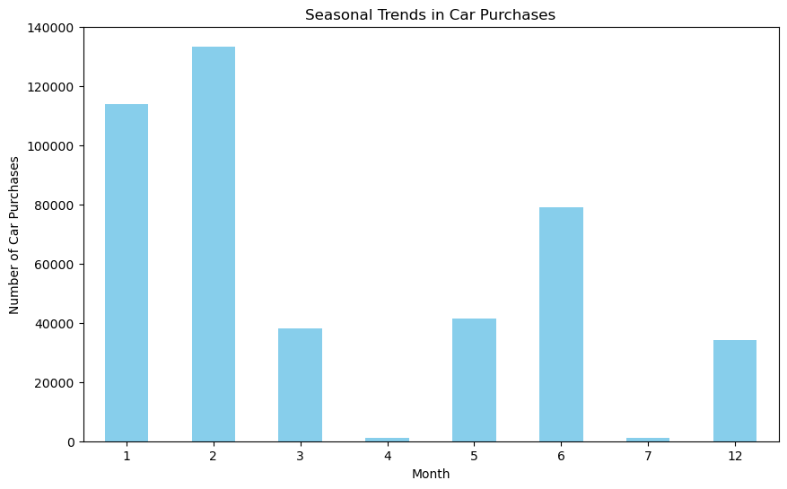
Explanatory Data Analysis Data Cleaning – Feature Explore
Car sale mostly done by the first quarter of the year or summer time.

Slide 12
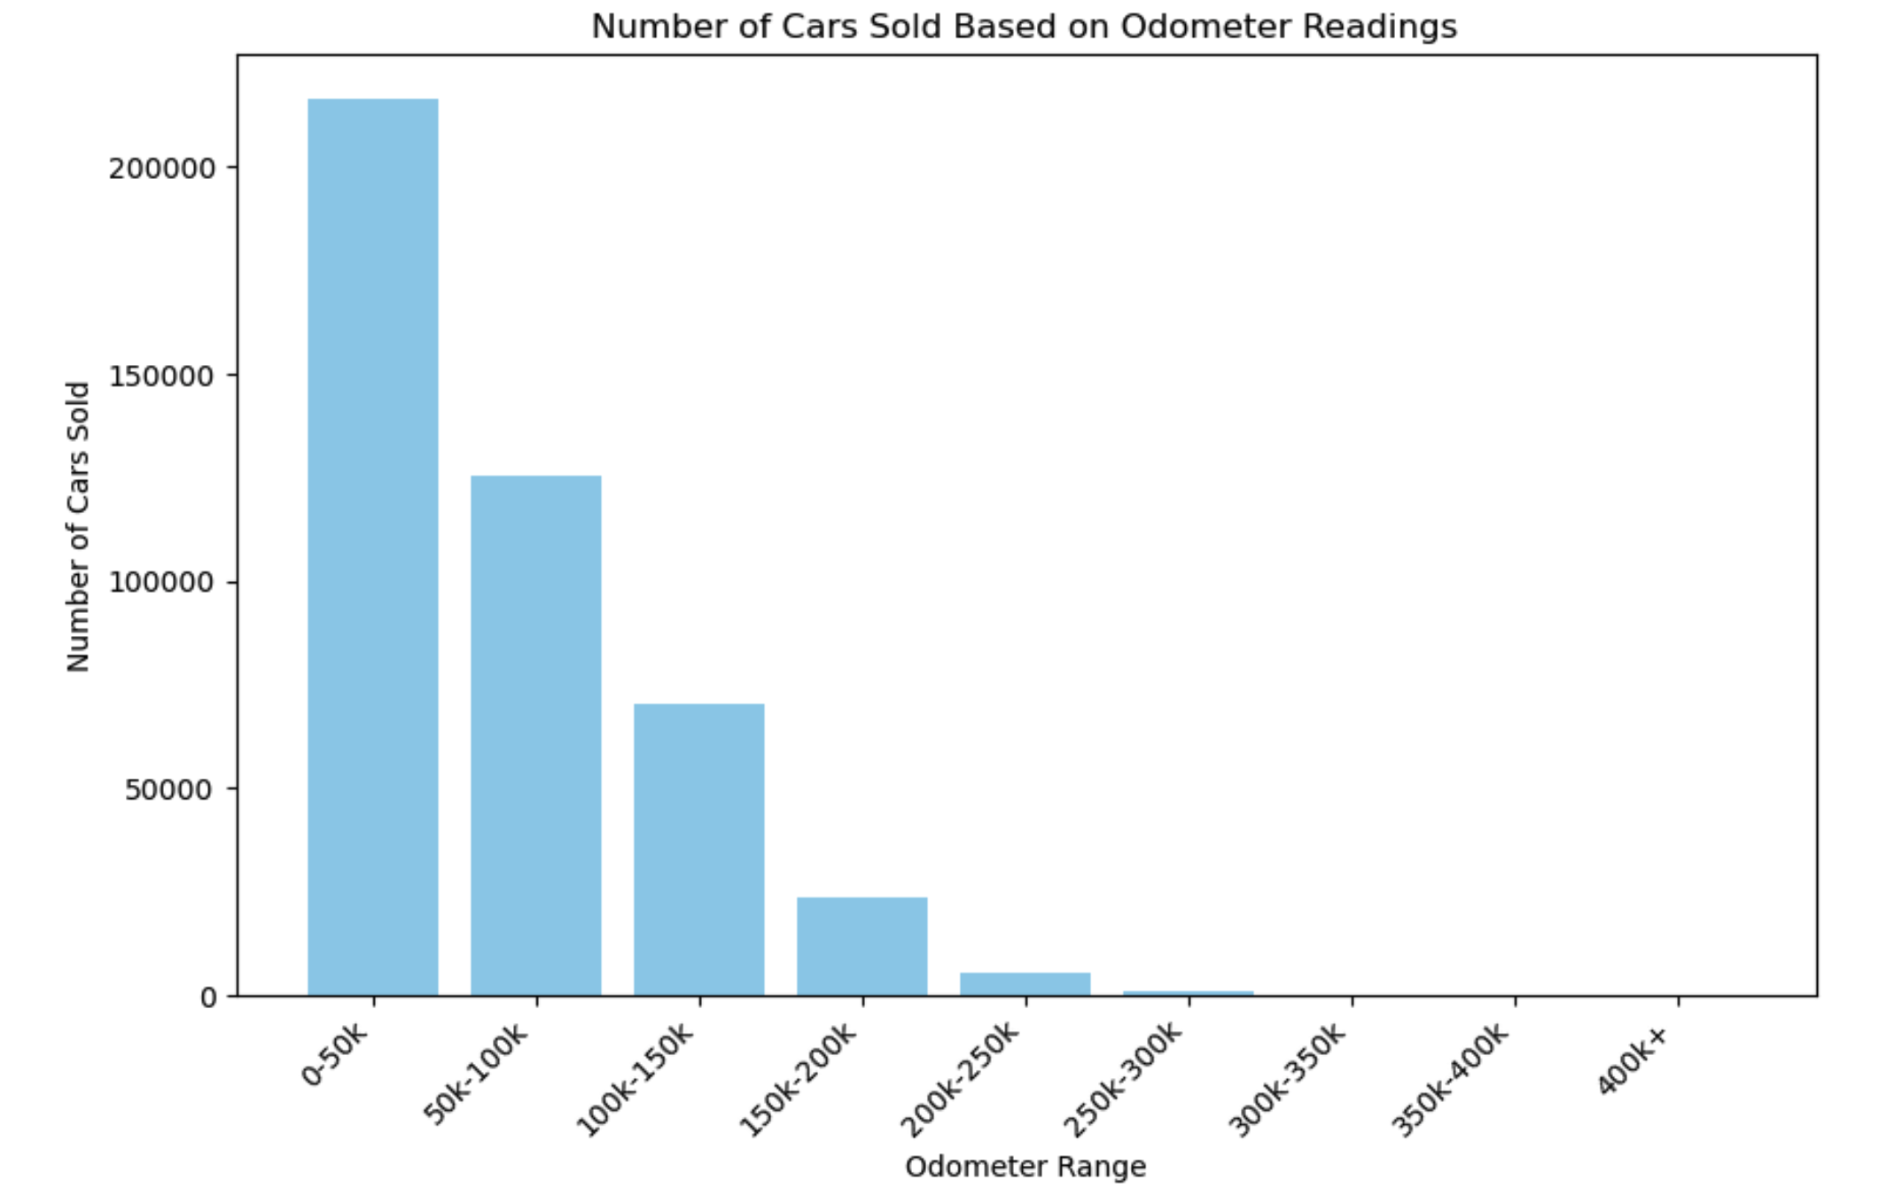
Explanatory Data Analysis Data Cleaning – Feature Explore
Mostly under 100K miles odomoter cars are selected to be sold.

Slide 13
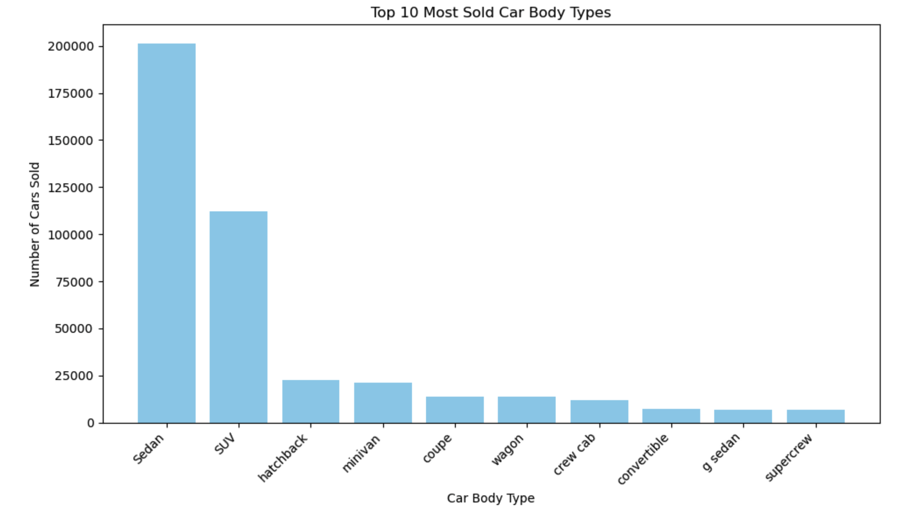
Explanatory Data Analysis Data Cleaning – Feature Explore
Top body type selected to be bought by the customers are sedan and SUV

Slide 14
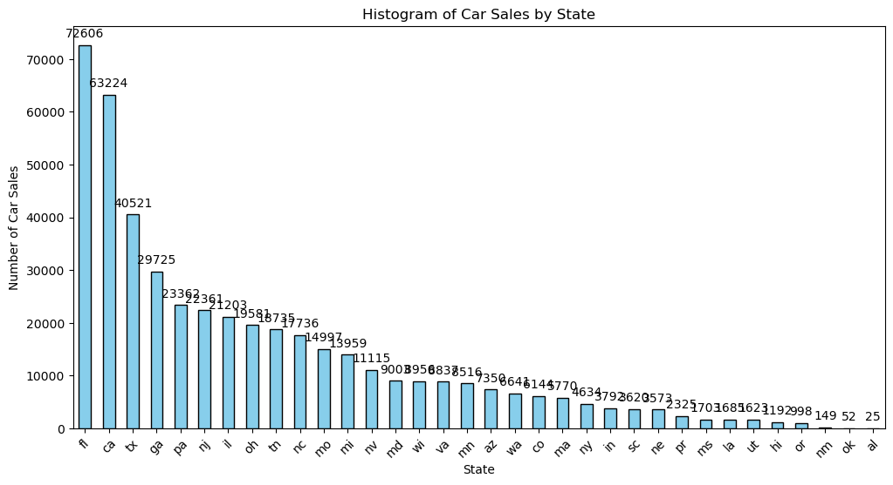
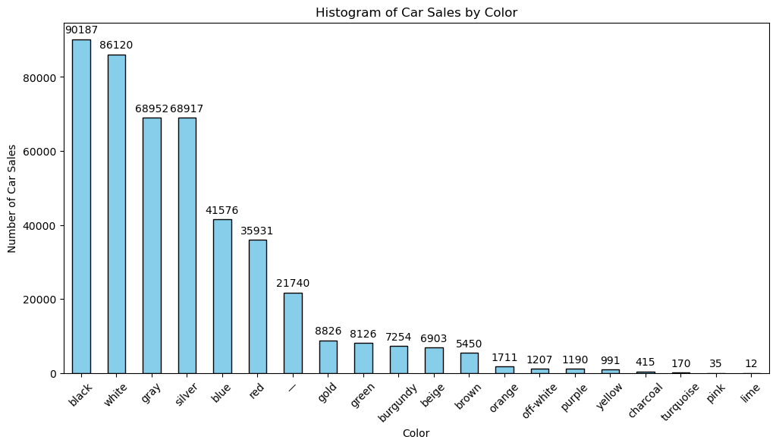
Explanatory Data Analysis Data Cleaning – Feature Explore
Car Sales by State
Car Sales by Color

Slide 15
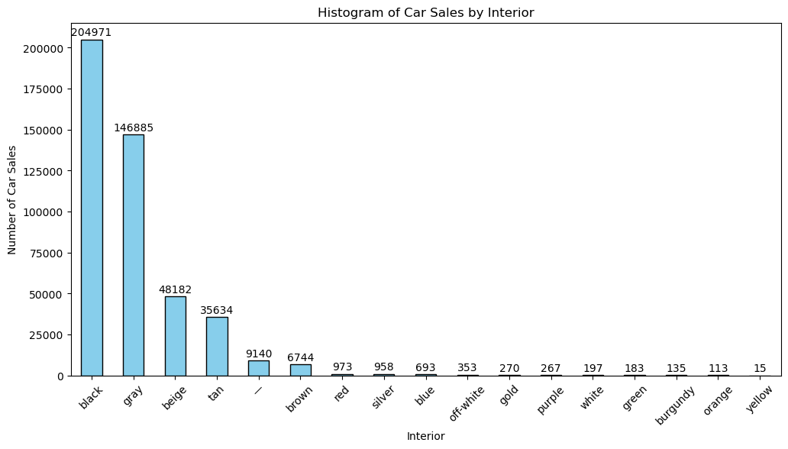
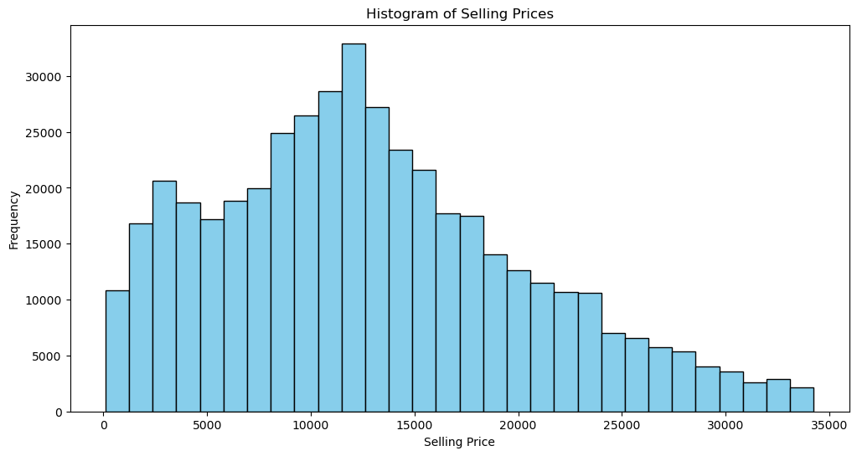
Explanatory Data Analysis Data Cleaning – Feature Explore
Car Sales by Interior
Car Sales by Selling Price

Slide 16
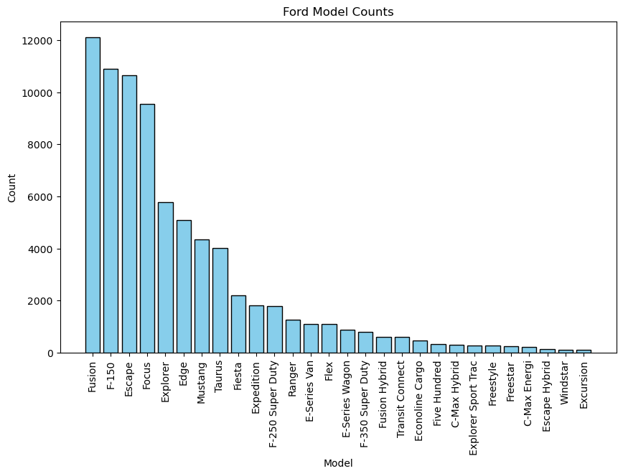
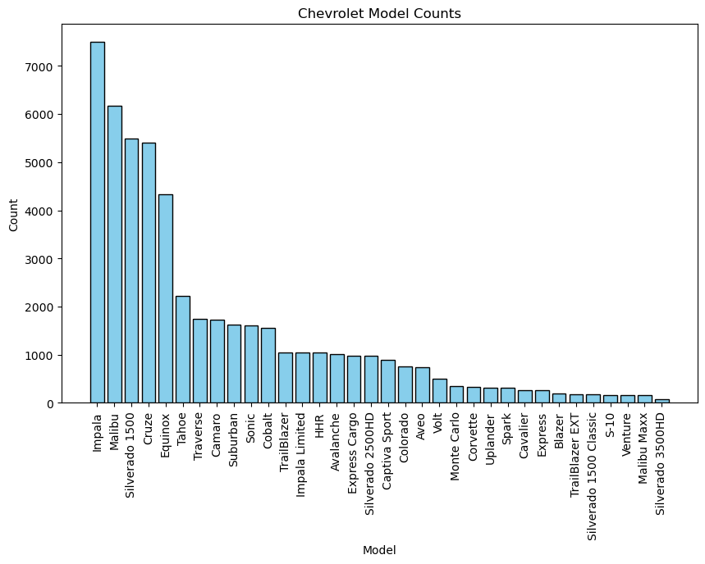
Explanatory Data Analysis Data Cleaning – Feature Explore
Ford Models by the Sale
Chevrolet Models by the Sale

Slide 17
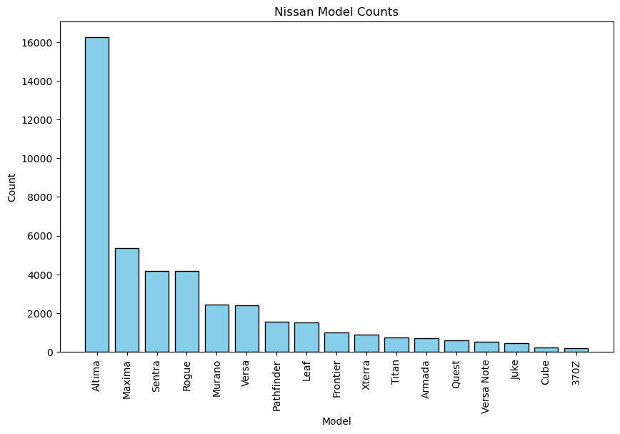
Explanatory Data Analysis Data Cleaning – Feature Explore
Nissan Models by the Sale

Slide 18
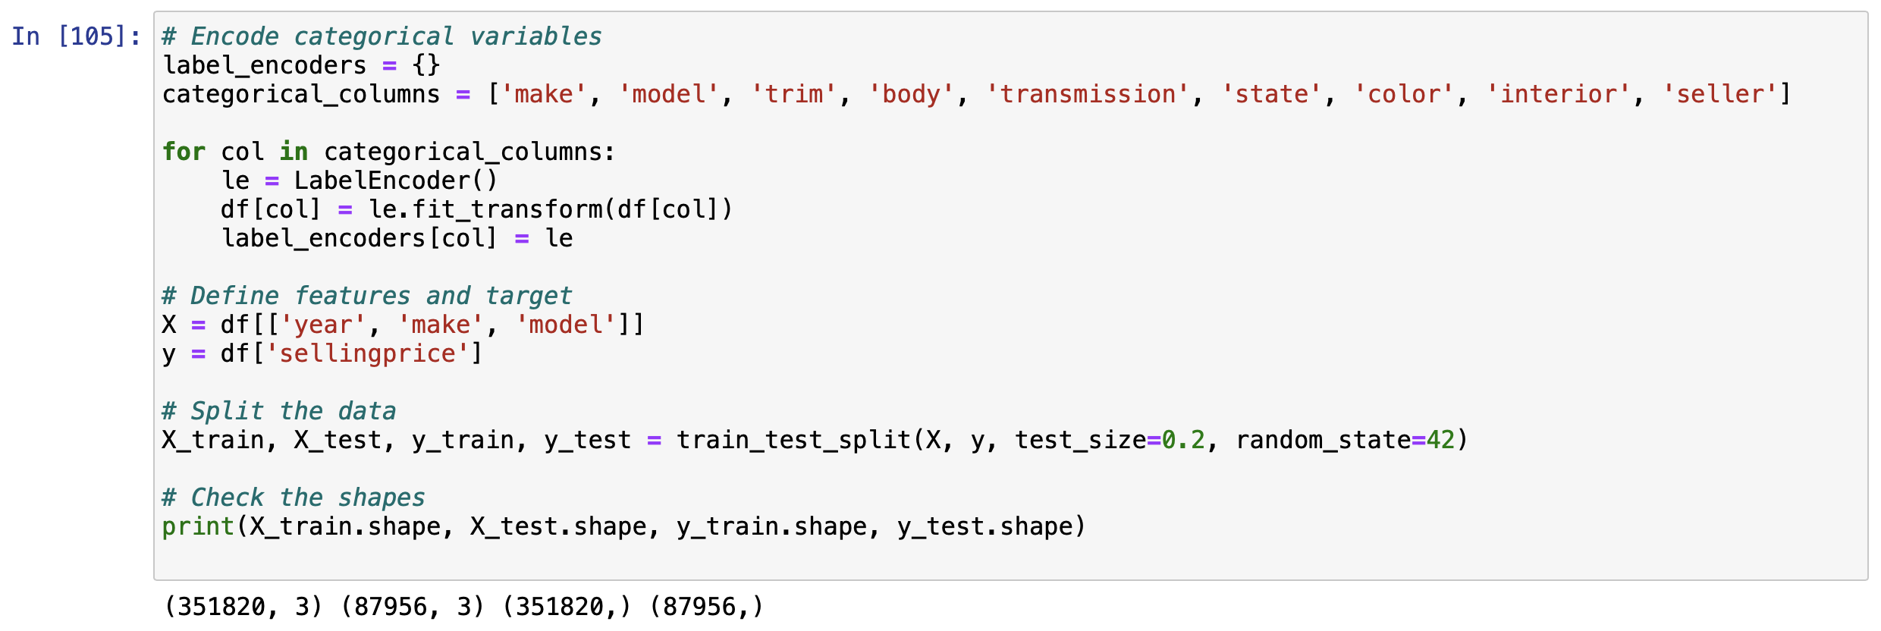
Model Evaluation Data Processing
Since we have a clean data we used label encoder to encode categorical variables like make, model, trim, body, transmission, state, color, interior, and seller into to numerical values. This is needed for the regression modelling.
Currently only year, make and model will be used. We included all categorical variables into label encoder for later use in case needed

Slide 19
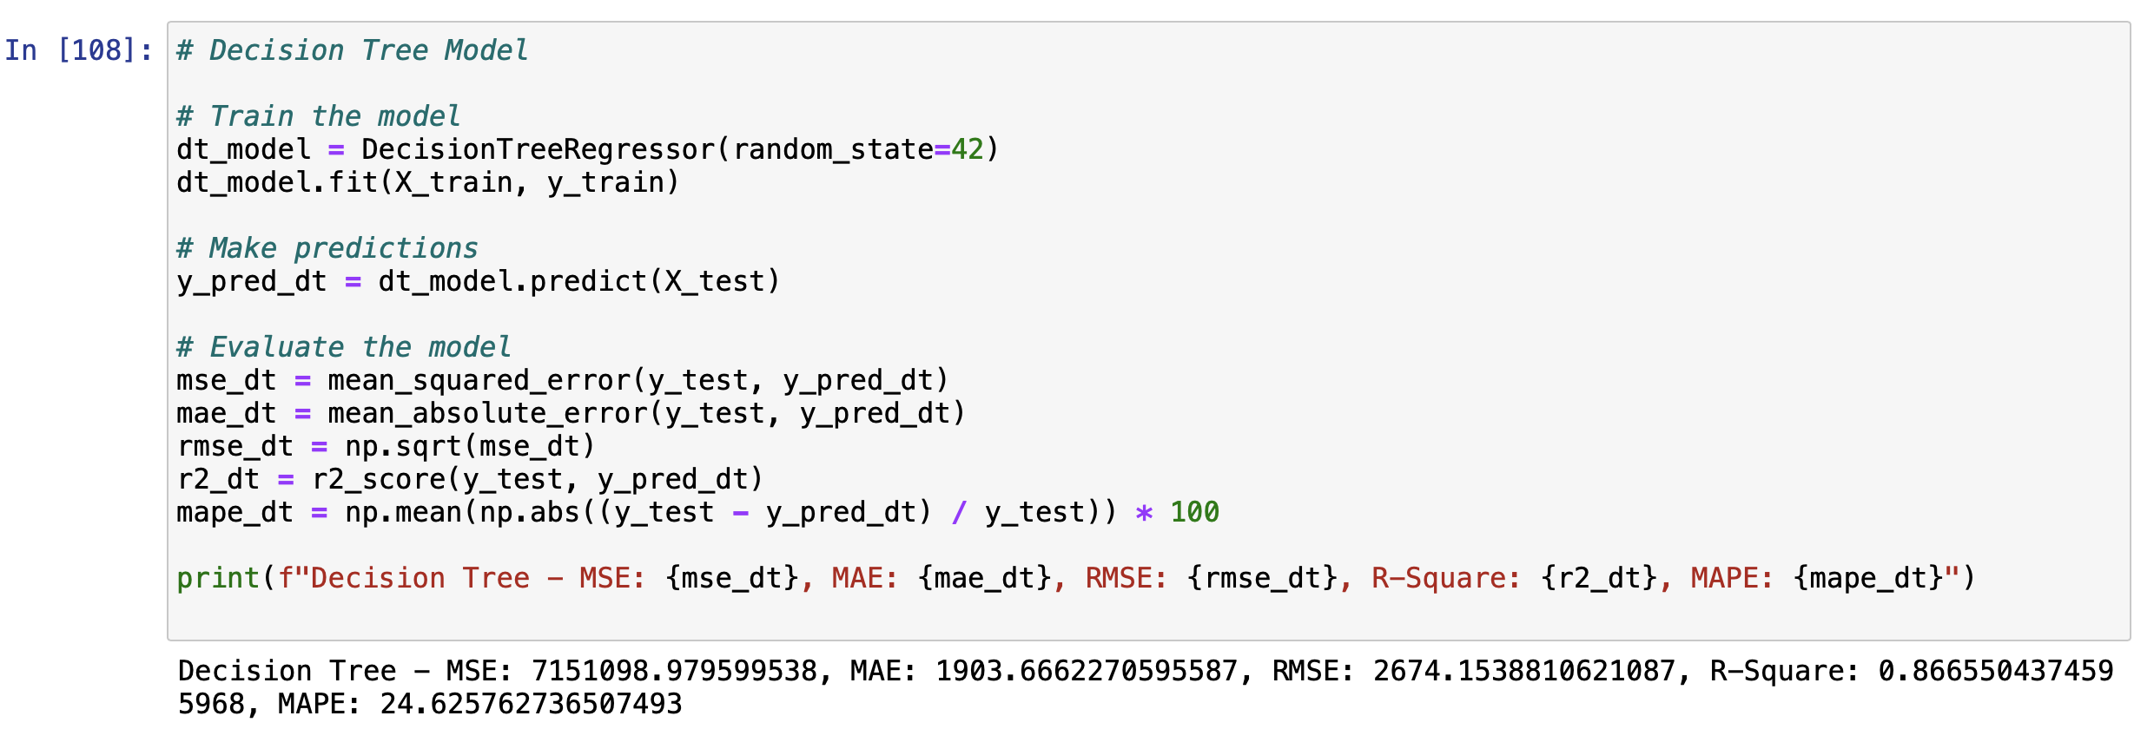
Model Evaluation Model Training and Evaluation – Decision Tree
Metric | Value
MSE | 7151098.979599538
MAE | 1903.6662270595587
RMSE | 2674.1538810621087
R-Square | 0.8665504374595968
MAPE | 24.625762736507493
Based on 1st algorithm (Decision Tree Regressor) we have found the below information

Slide 20
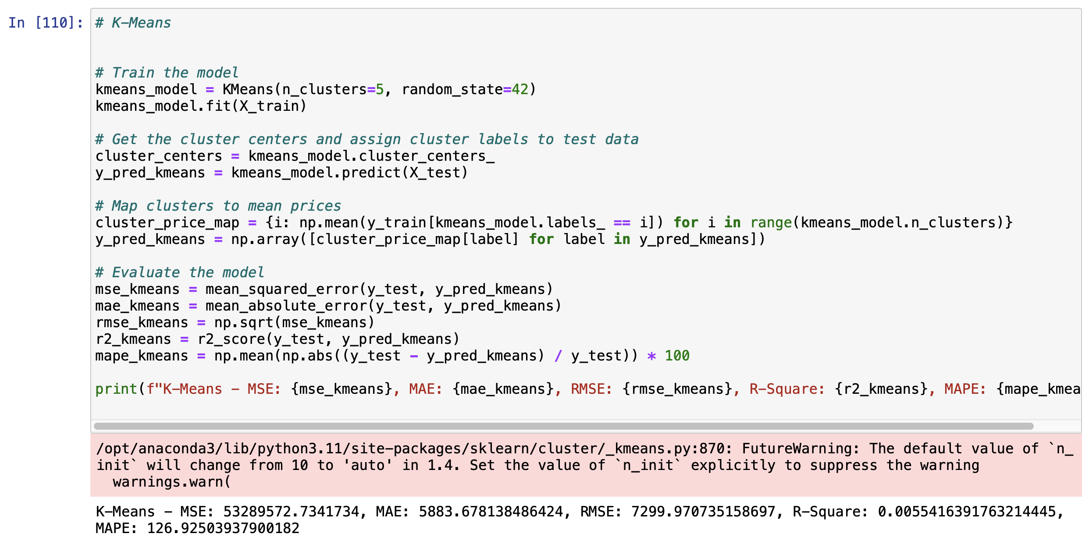
Model Evaluation Model Training and Evaluation – K-Means
Metric | Value
MSE | 53289572.7341734
MAE | 5883.678138486424
RMSE | 7299.970735158697
R-Square | 0.0055416391763214445
MAPE | 126.92503937900182
Based on 2nd algorithm (K-Means) we have found the below information

Slide 21
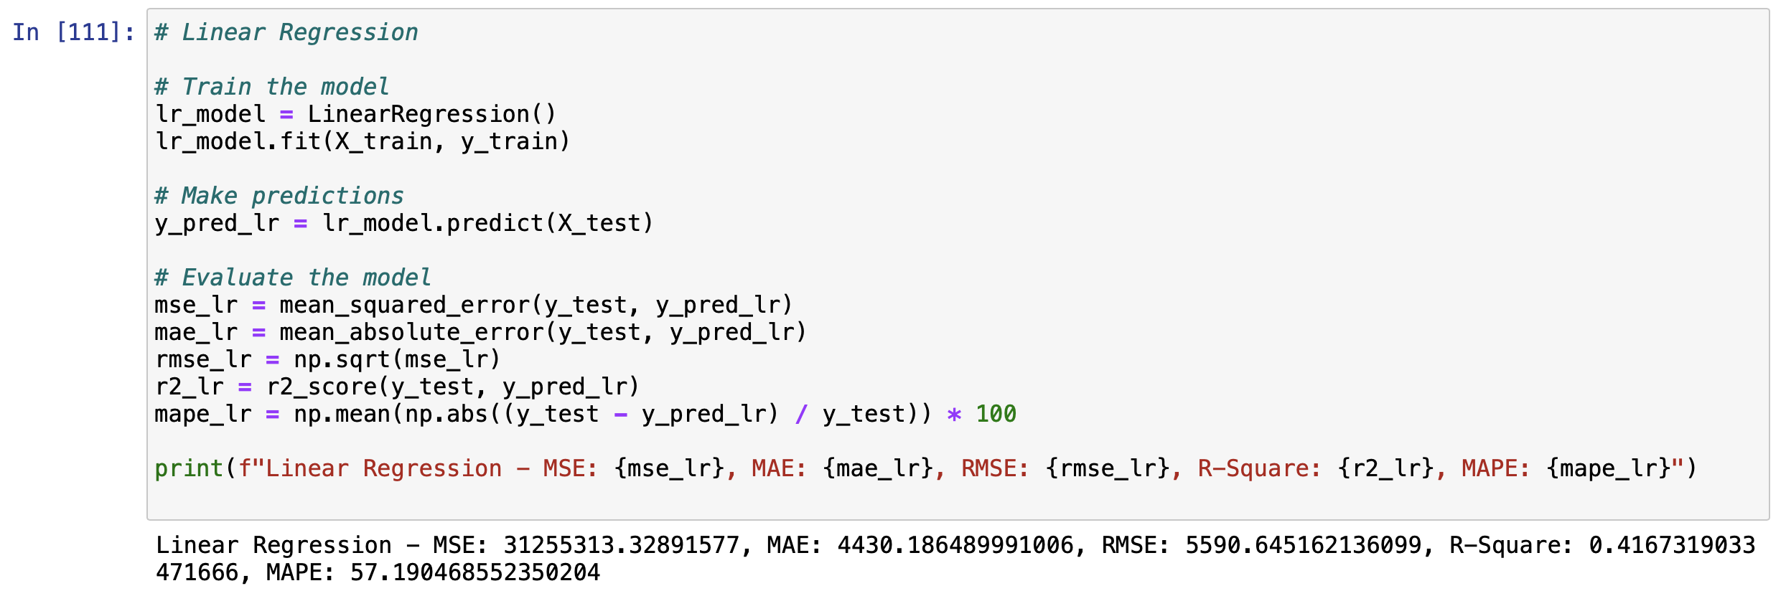
Model Evaluation Model Training and Evaluation – Linear Regression
Metric | Value
MSE | 31255313.32891577
MAE | 4430.186489991006
RMSE | 5590.645162136099
R-Square | 0.4167319033471666
MAPE | 57.190468552350204
Based on 3rd algorithm (Linear Regression) we have found the below information

Slide 22
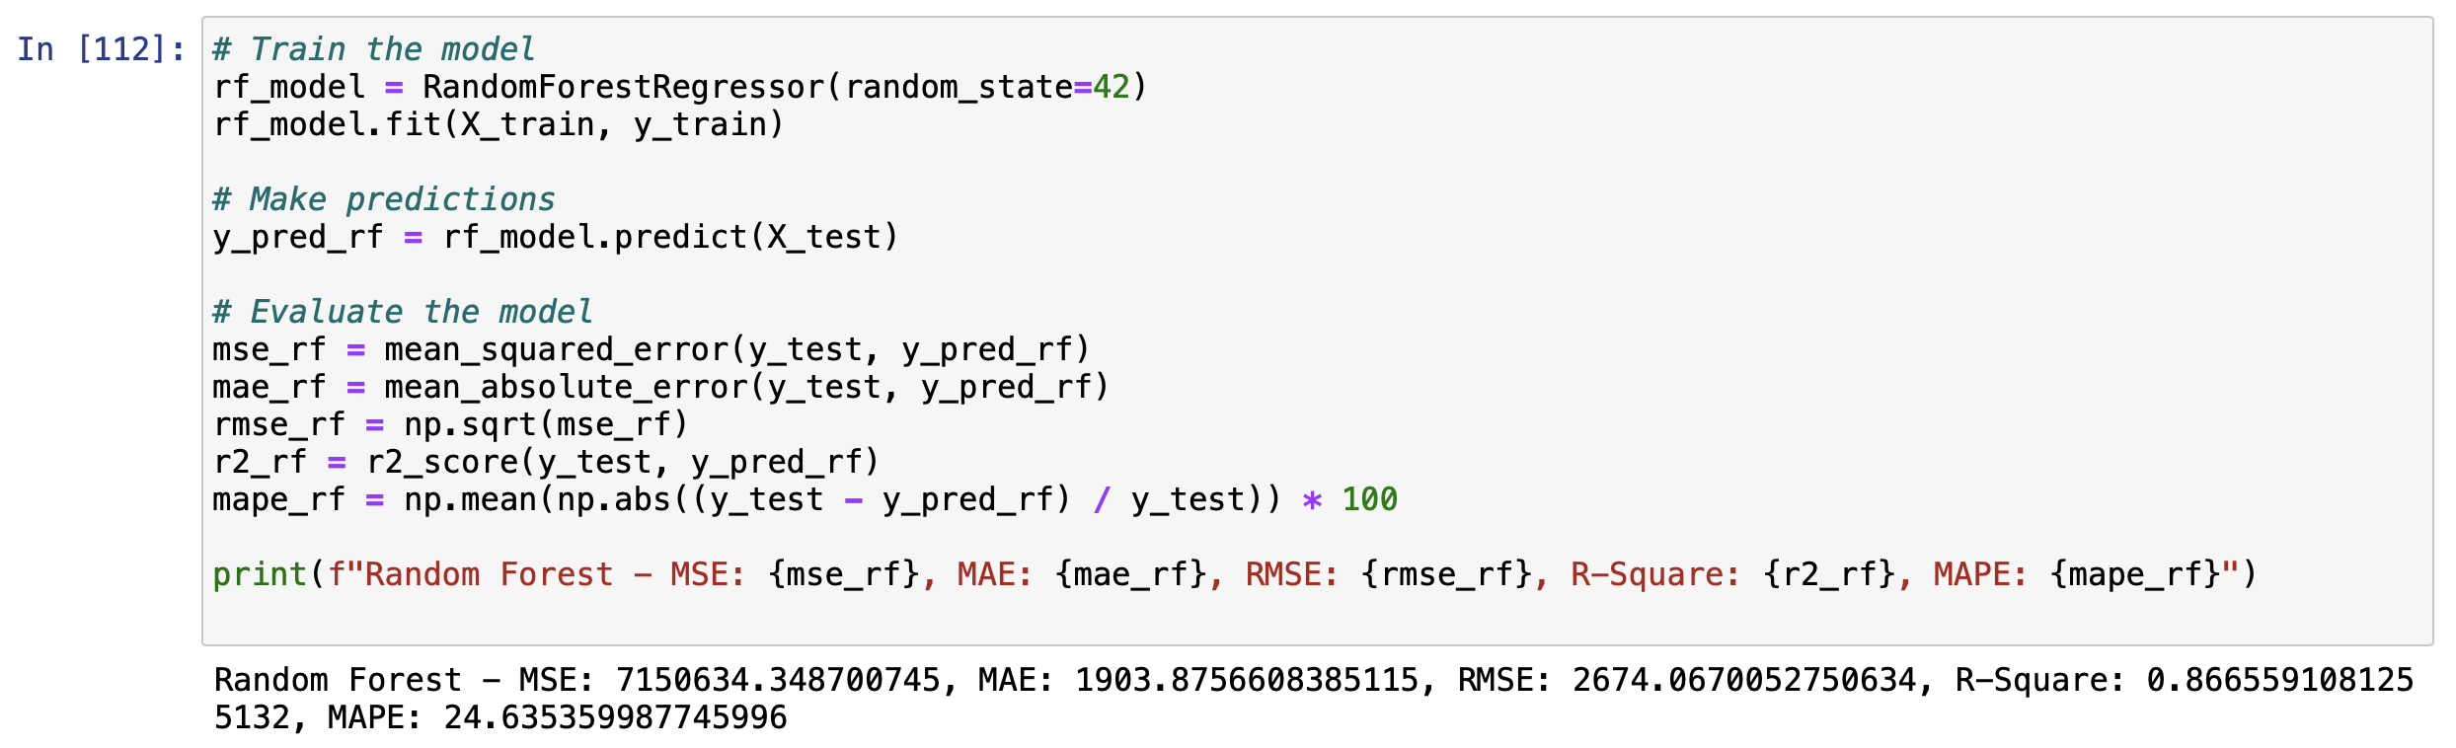
Model Evaluation Model Training and Evaluation – Ensemble Method
Metric | Value
MSE | 7150634.348700745
MAE | 1903.8756608385115
RMSE | 2674.0670052750634
R-Square | 0.8665591081255132
MAPE | 24.635359987745996
We used Random Forest Regressor for the ensemble method

Slide 23
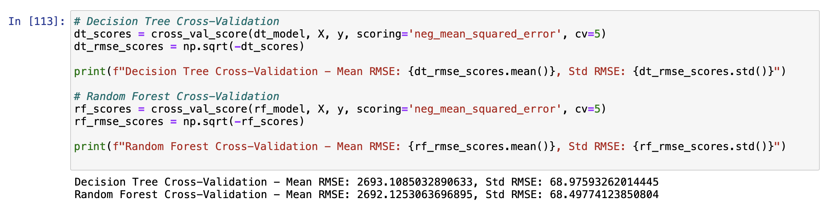
Model Evaluation Model Training and Evaluation – Cross Validation
Decision Tree and Random Forest CV calculated and the result as seen below:
Decision Tree Cross-Validation :
Mean RMSE: 2693.1085032890633
Std RMSE: 68.97593262014445
Random Forest Cross-Validation:
Mean RMSE: 2692.1253063696895
Std RMSE: 68.49774123850804

Slide 24
Model Evaluation Model Training and Evaluation – Compare Results
Model | MSE | MAE | RMSE | R-Square | MAPE
Decision Tree | 7.337042e+06 | 1919.426589 | 2708.697485 | 0.868552 | 24.336221
K-Means | 5.547684e+07 | 5984.487365 | 7448.277989 | 0.006094 | 127.252308
Linear Regression | 3.266376e+07 | 4506.224067 | 5715.221462 | 0.414806 | 57.165565
Random Forest | 7.340317e+06 | 1919.663910 | 2709.302007 | 0.868493 | 24.338147
The Decision Tree model performs well with a high R-Square value (0.896) indicating that it explains 89.6% of the variance in the target variable. It has the lowest MAE and relatively low MAPE, suggesting it makes smaller errors on average.
The K-Means model performs poorly in this regression task, which is expected since K-Means is primarily a clustering algorithm and not typically used for regression. It has the highest MSE, MAE, RMSE, and MAPE, and the R-Square value is close to zero, indicating it does not explain the variance in the target variable well.

Slide 25
Model Evaluation Model Training and Evaluation – Compare Results
The Linear Regression model has moderate performance with an R-Square value of 0.342, explaining 34.2% of the variance in the target variable. The MSE, MAE, and RMSE values are higher than those of the Decision Tree and Random Forest, indicating larger prediction errors. The MAPE is also high at 79.72%, suggesting less reliable predictions.
The Random Forest model performs similarly to the Decision Tree model with a high R-Square value (0.895), indicating that it explains 89.5% of the variance in the target variable. It has the lowest MAE and MAPE values, suggesting it makes small errors on average, comparable to the Decision Tree model.

Slide 26
Model Evaluation Feature Engineering– Compare Results (Condition Feature Addition)
Model | Metric | Without Condition | With Condition | Improvement
Decision Tree | MSE | 7,337,042 | 6,571,280 | 10.45%
 | MAE | 1,919.43 | 1,788.89 | 6.80%
 | RMSE | 2,708.70 | 2,563.45 | 5.36%
 | R-Squared | 0.8686 | 0.8823 | 1.57%
 | MAPE | 24.34% | 21.78% | 10.51%
K-Means | MSE | 55,476,845 | 55,461,963 | N/A
 | MAE | 5,984.49 | 5,983.16 | N/A
 | RMSE | 7,448.28 | 7,447.28 | N/A
 | R-Squared | 0.0061 | 0.0064 | N/A
 | MAPE | 127.25% | 127.22% | N/A
Model | Metric | Without Condition | With Condition | Improvement
Linear Regression | MSE | 32,663,756 | 30,471,313 | 6.71%
 | MAE | 4,506.22 | 4,322.06 | 4.08%
 | RMSE | 5,715.22 | 5,520.08 | 3.42%
 | R-Squared | 0.4148 | 0.4541 | 9.47%
 | MAPE | 57.17% | 55.58% | 2.78%
Random Forest | MSE | 7,340,317 | 6,531,224 | 11.01%
 | MAE | 1,919.66 | 1,785.93 | 6.96%
 | RMSE | 2,709.30 | 2,555.63 | 5.67%
 | R-Squared | 0.8685 | 0.8830 | 1.67%
 | MAPE | 24.34% | 21.80% | 10.43%
Adding the condition category variable significantly improved the performance of the Decision Tree and Random Forest models. Linear Regression also saw improvements, though less pronounced. The K-Means model did not benefit notably from the additional feature. This suggests that the condition category variable provides meaningful information that enhances the prediction accuracy of the regression models.

Slide 27
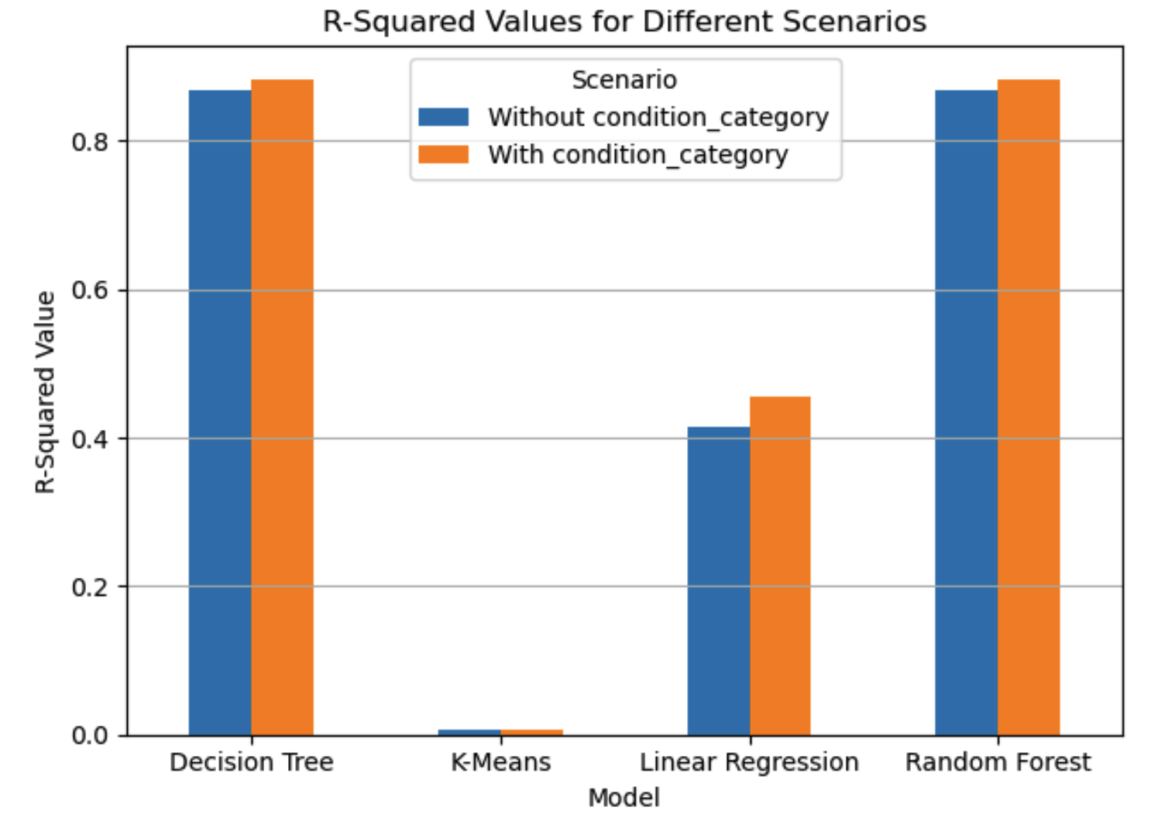
Model Evaluation Summary
Best Performers: Both the Decision Tree and Random Forest models perform the best with very similar metrics. They have high R-Square values, indicating good explanatory power, and low error metrics (MSE, MAE, RMSE, MAPE).
Moderate Performer: The Linear Regression model performs moderately with a lower R-Square value and higher error metrics compared to the Decision Tree and Random Forest models.
Poor Performer: The K-Means model performs poorly for this regression task with high error metrics and a very low R-Square value.

Slide 28
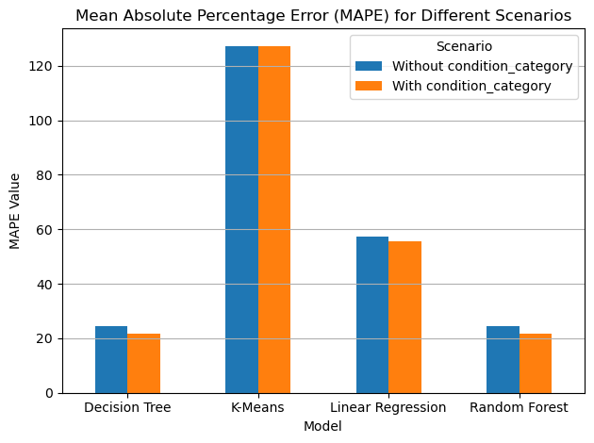
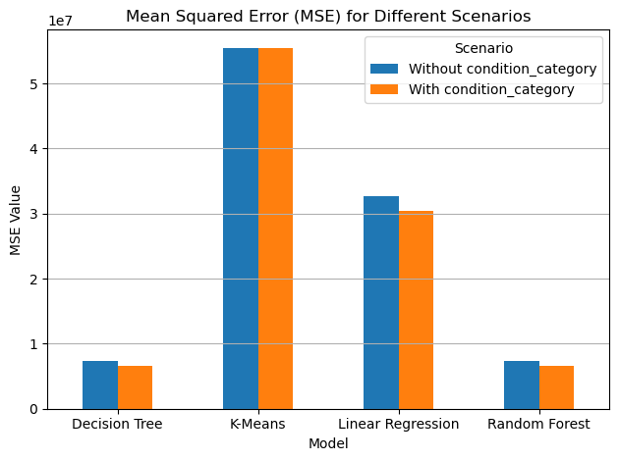
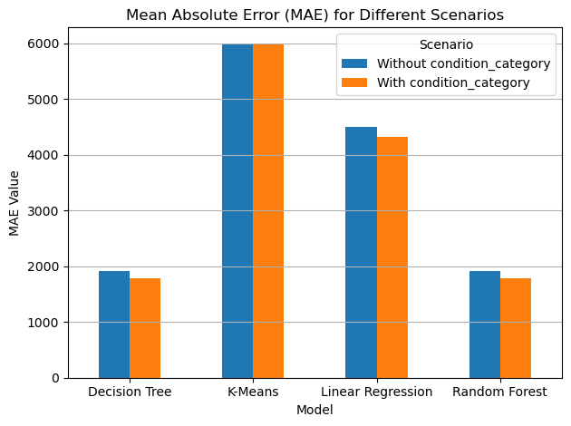
Thank You

